Slide 1



Automated Feature Extraction for High-Throughput Synchrotron Characterization
SSRL / SLAC
Robert Tang-Kong, Alexander Ivanov, Suchismita Sarker, Jeffrey Scargle, Apurva Mehta

Slide 2
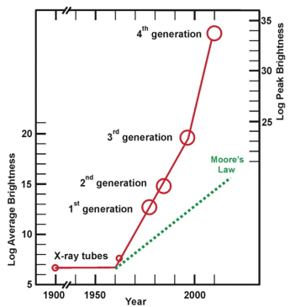
Light Sources Brighter than Ever Before
We can do more experiments, so where are the publications?
J. B. Parise and G. E. Brown, Jr. Elements, 2, 37-42 (2006)
<number>
Notes:
You all know this, preaching to the choir
Measurements vs knowledge
Rate of discovery, why?
Caveat: problems are getting more complex, need more data
End result is still lots of data that is not being analyzed
2006: 100 patterns a day
LCLS: >1E4-6 patterns per day
<number>

Slide 3
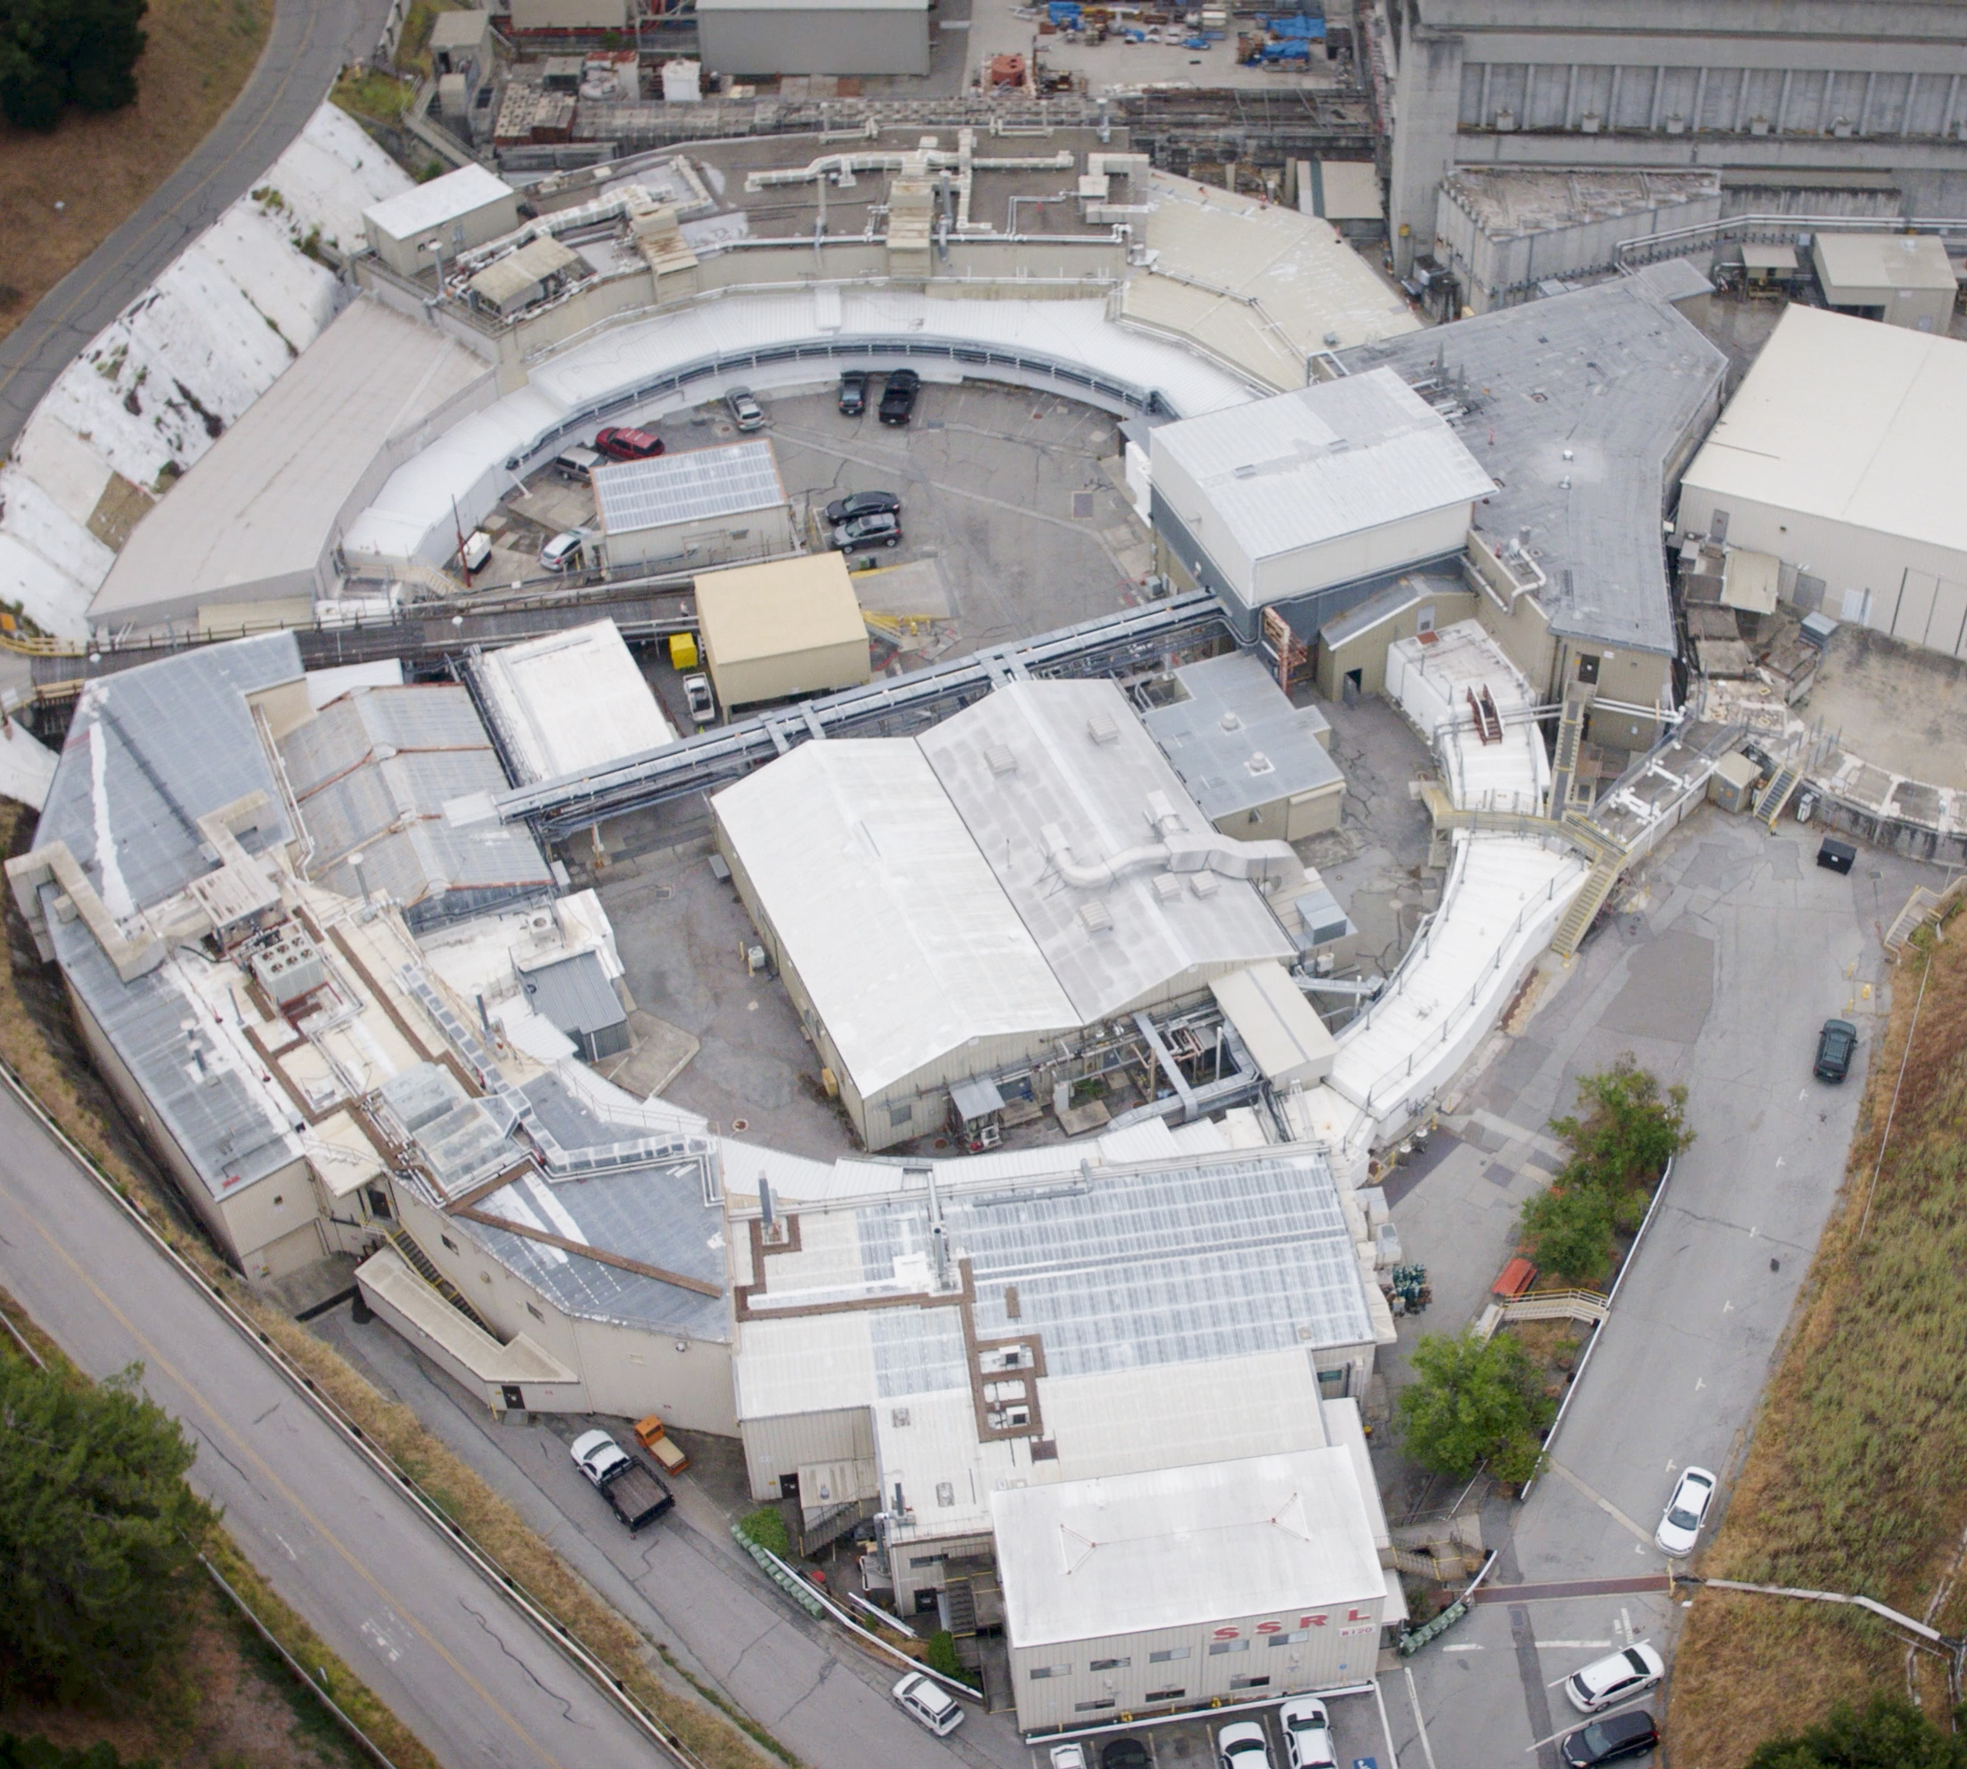
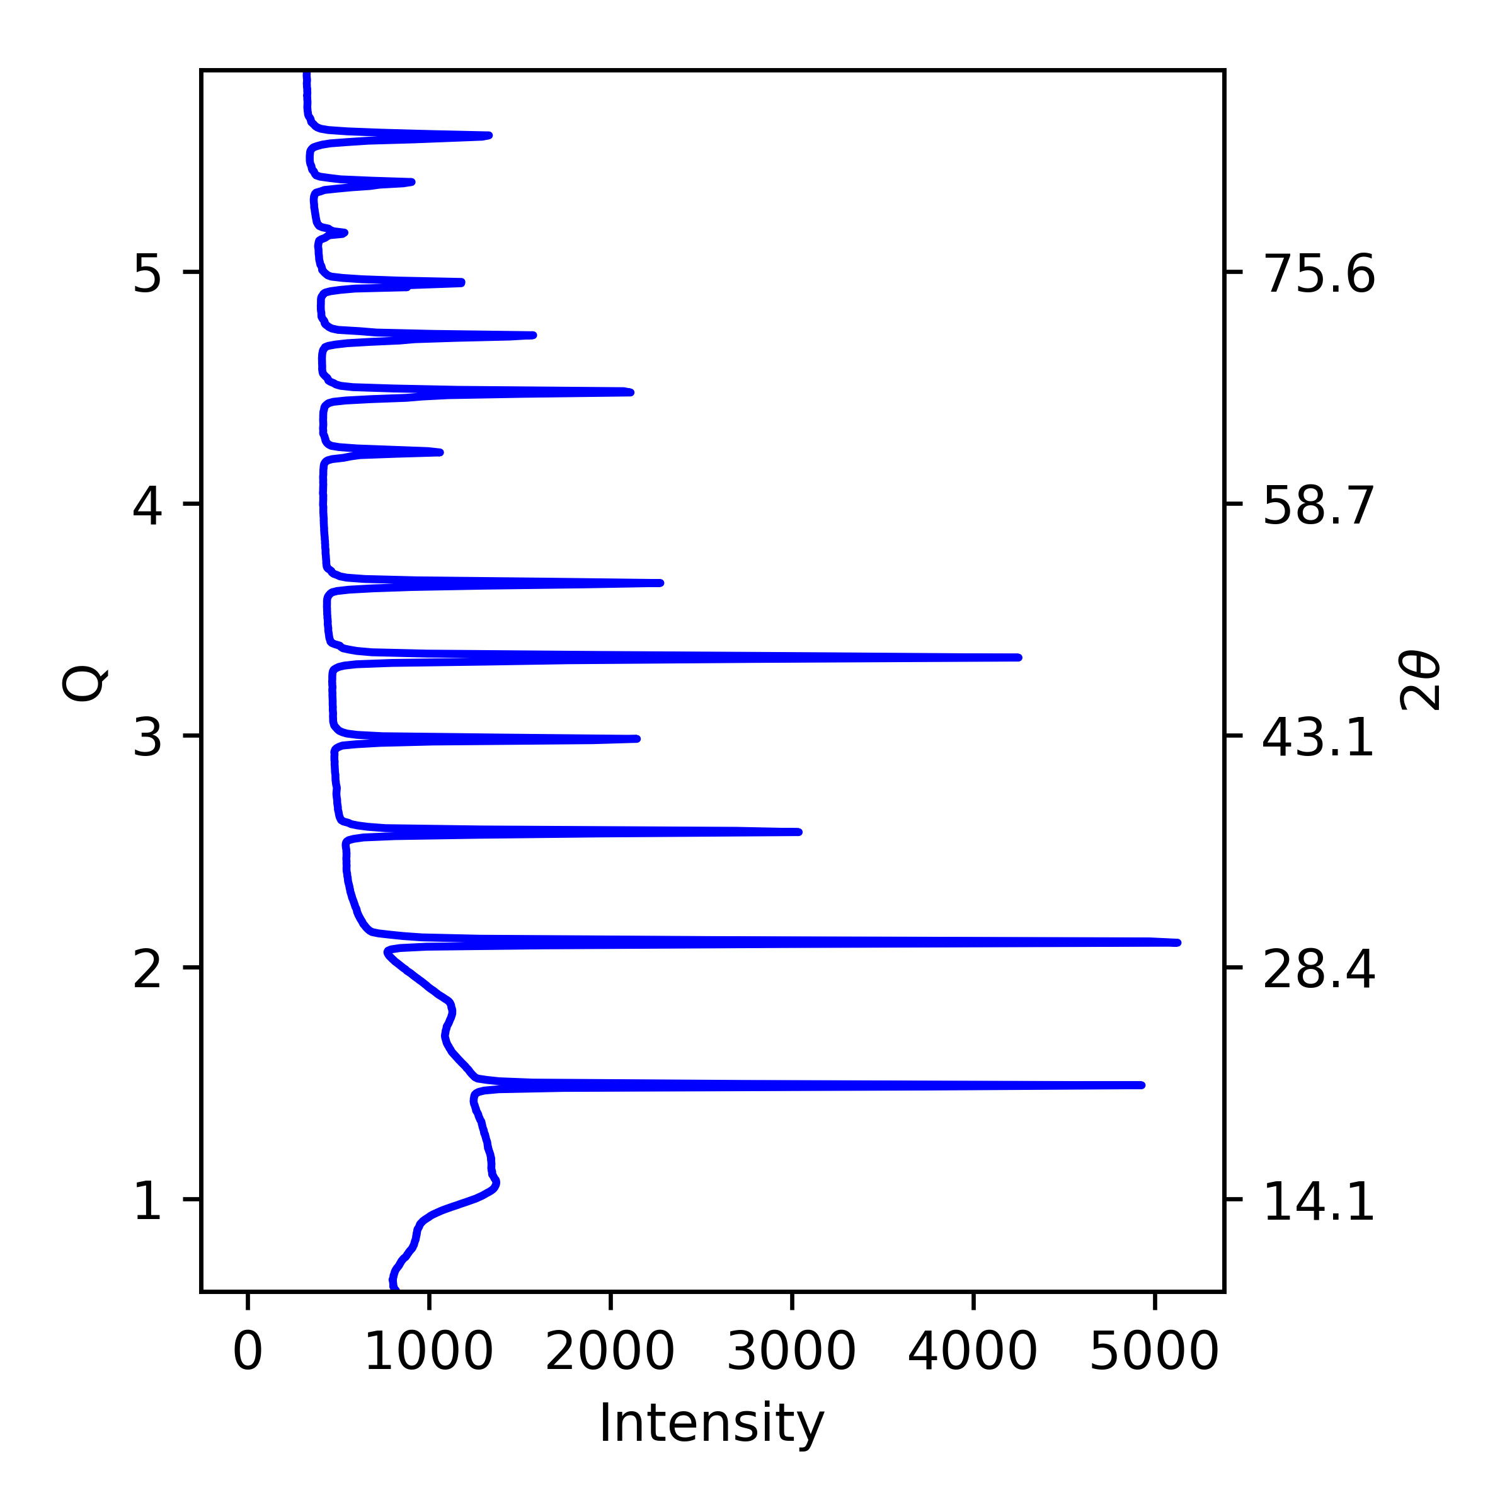
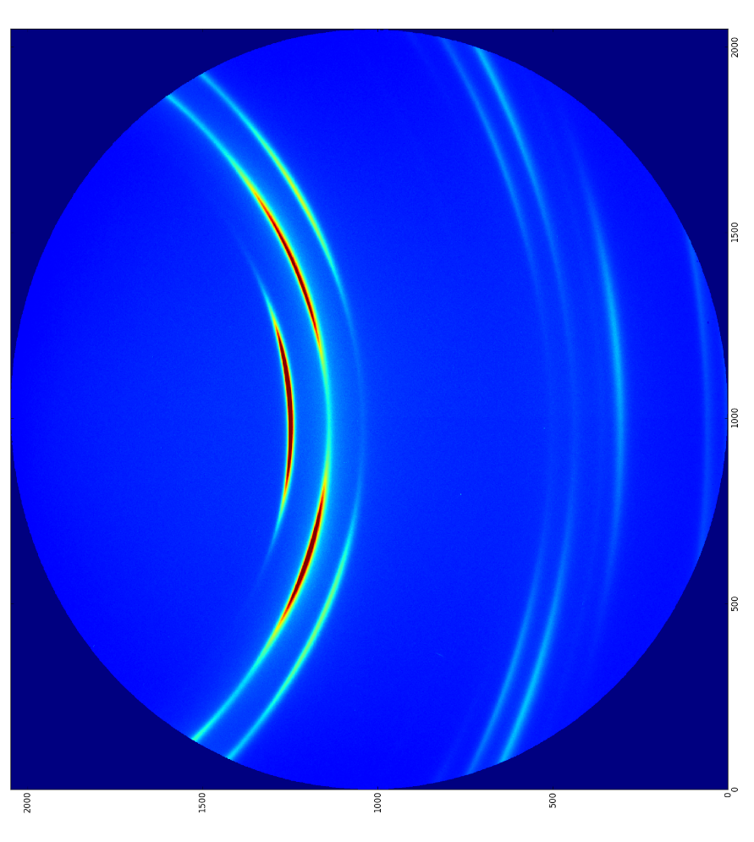
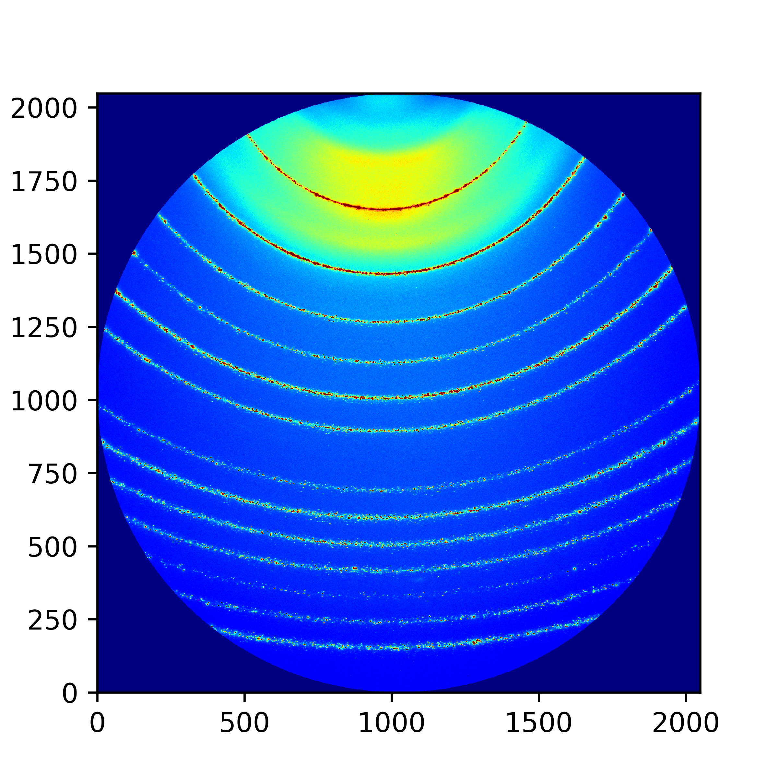
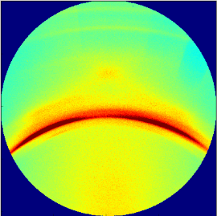
The New Bottle Neck
Measurement
Analysis
Discoveries/ Knowledge
ID | No. peaks | FWHM | Noise
… | … | … | …
1 | 2 | 0.5 | 0.07
2 | 4 | 0.3 | 0.50
… | … | … | …
<number>
Notes:
<number>

Slide 4
The New Bottle Neck
Measurement
Analysis
Discoveries/ Knowledge
ID | No. peaks | FWHM | Noise
… | … | … | …
1 | 2 | 0.5 | 0.07
2 | 4 | 0.3 | 0.50
… | … | … | …
<number>
Notes:
<number>

Slide 5
The New Bottle Neck
Measurement
Analysis
Discoveries/ Knowledge
ID | No. peaks | FWHM | Noise
… | … | … | …
1 | 2 | 0.5 | 0.07
2 | 4 | 0.3 | 0.50
… | … | … | …
<number>
Notes:
<number>

Slide 6
Feature Extraction
ID | No. peaks | FWHM | Noise
… | … | … | …
1 | 2 | 0.5 | 0.07
2 | 4 | 0.3 | 0.50
… | … | … | …
Quickly
Accurately
Without prior Knowledge
<number>
Notes:
<number>

Slide 7
Feature Extraction
<number>
Notes:
<number>

Slide 8
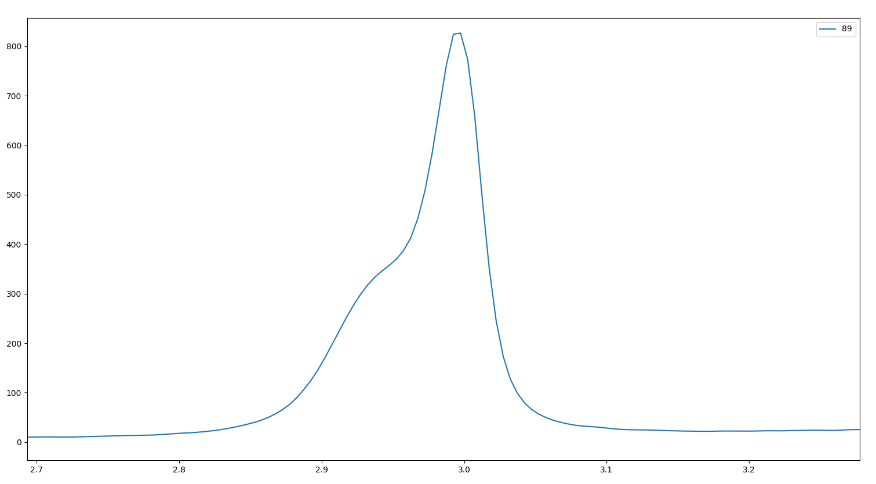
Challenges of Detecting Peaks
Overlapping Peaks
<number>
Notes:
<number>

Slide 9
Challenges of Detecting Peaks
Overlapping Peaks
<number>
Notes:
<number>

Slide 10
Challenges of Detecting Peaks
Overlapping Peaks
<number>
Notes:
<number>

Slide 11
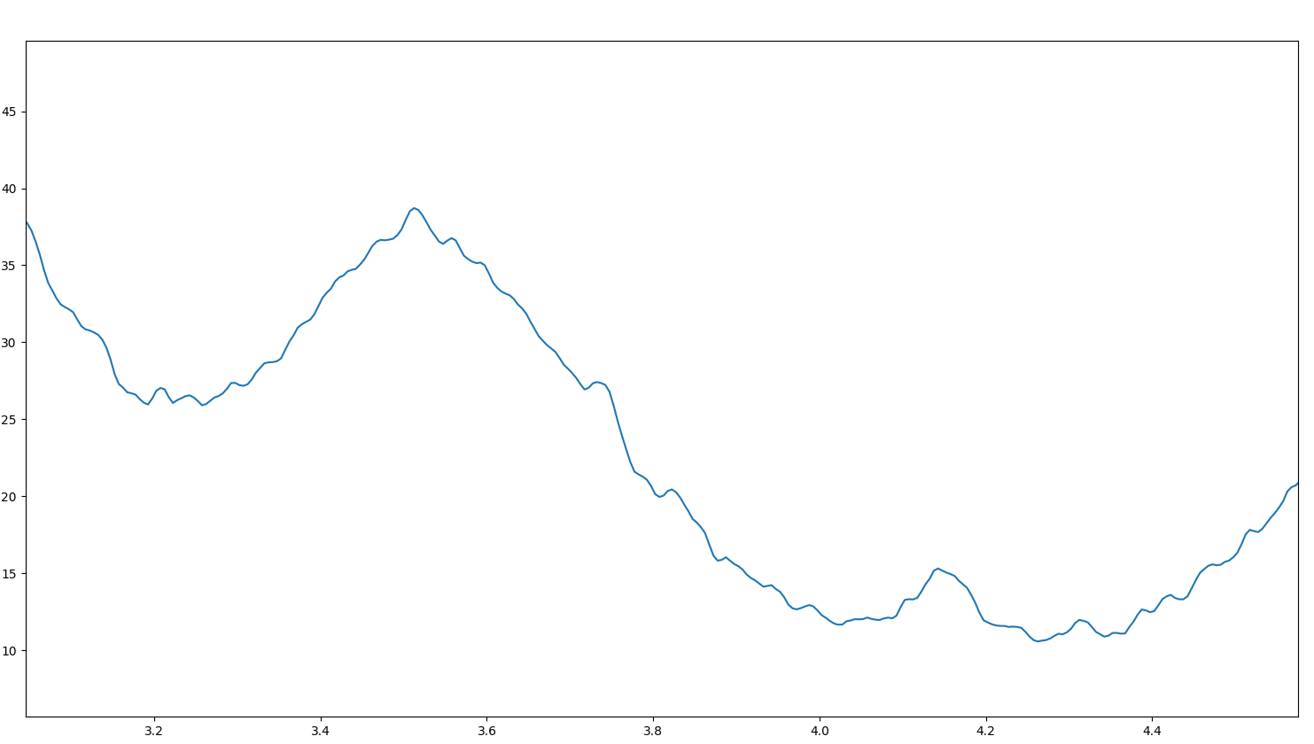
Challenges of Detecting Peaks
Noisy Data
<number>
Notes:
<number>

Slide 12
Challenges of Detecting Peaks
Noisy Data
<number>
Notes:
<number>

Slide 13
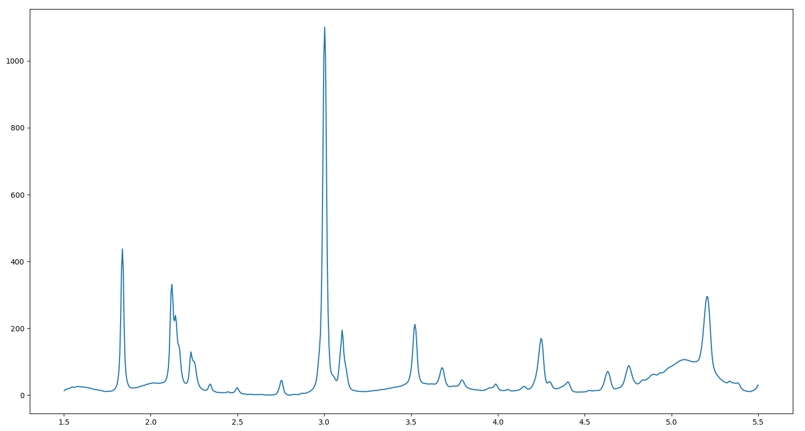
Challenges of Detecting Peaks
Curve Fitting
<number>
Notes:
<number>

Slide 14
Challenges of Detecting Peaks
Curve Fitting
Number of peaks
Computationally hard
<number>
Notes:
<number>

Slide 15
Challenges of Detecting Peaks
Curve Fitting
Number of peaks
Computationally hard
<number>
Notes:
<number>

Slide 16
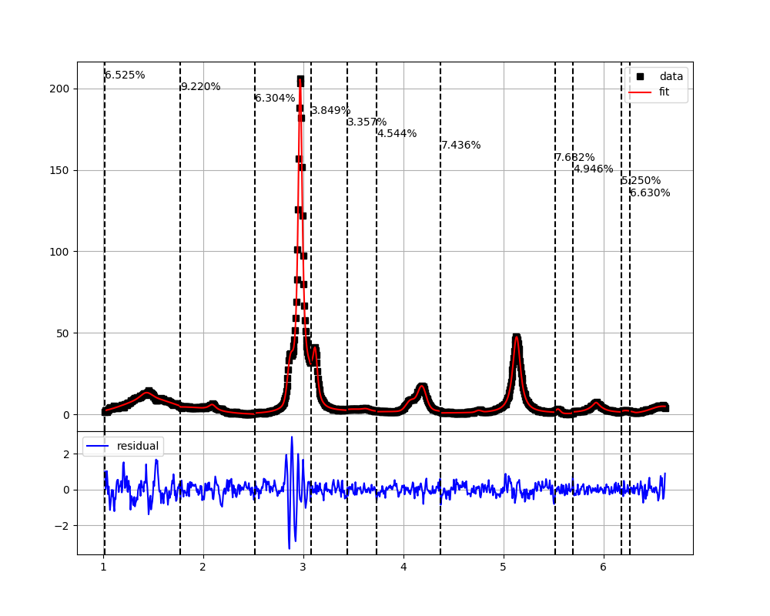
Bayesian Block Analysis
Bayesian Block Analysis for Peak Detection
Block data into statistically similar regions.
Hill climbing on blocks
Produce peak regions for curve fitting
<number>
Notes:
<number>

Slide 17
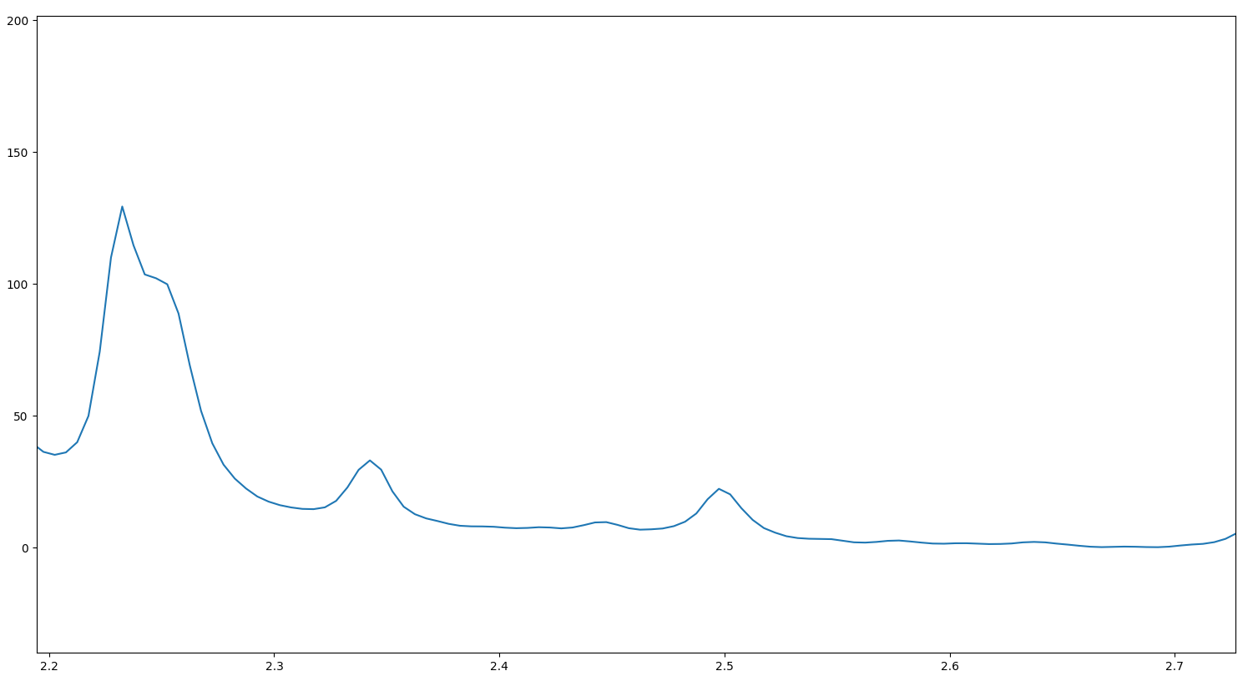
Bayesian Block Analysis
<number>
Notes:
<number>

Slide 18
Bayesian Block Analysis
<number>
Notes:
<number>

Slide 19
Bayesian Block Analysis
<number>
Notes:
<number>

Slide 20
Bayesian Block Analysis
<number>
Notes:
<number>

Slide 21
Bayesian Block Analysis
<number>
Notes:
<number>

Slide 22
Bayesian Block Analysis
1
2
3
<number>
Notes:
<number>

Slide 23
Bayesian Block Analysis
1
2
3
<number>
Notes:
<number>

Slide 24
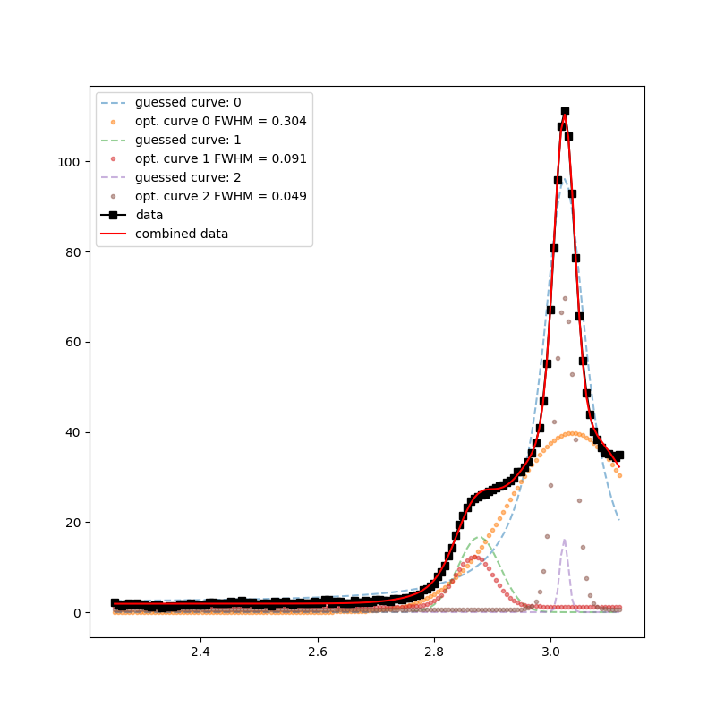
Iterative Curve Fitting
Need: Profile Shape Function
Voigt profile
Symetric
Algorithm
Place curve at peak in data
Subtract curve to get new data
Repeat until all curves are placed
Optimize all curves together on original data
<number>

Slide 25
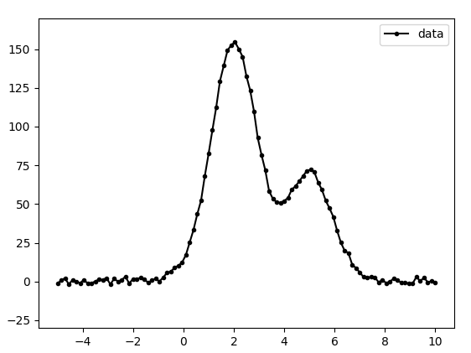
Iterative Curve Fitting: Noisy Peaks
<number>
Notes:
<number>

Slide 26
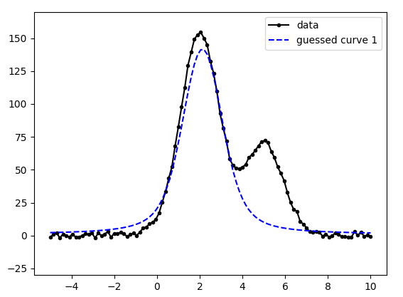
Iterative Curve Fitting: Noisy Peaks
<number>
Notes:
<number>

Slide 27
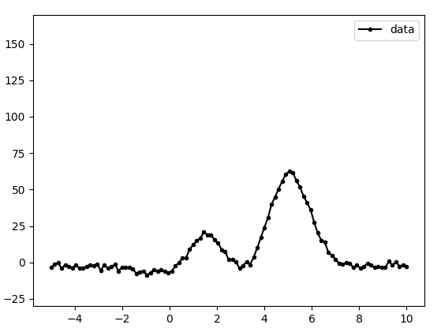
Iterative Curve Fitting: Noisy Peaks
<number>
Notes:
<number>

Slide 28
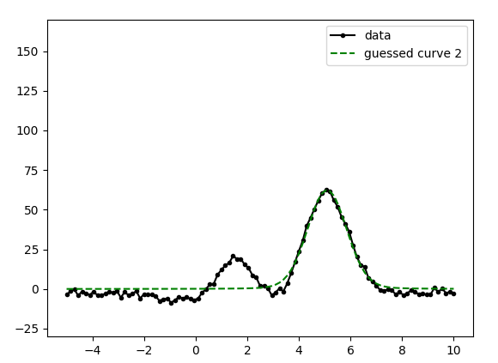
Iterative Curve Fitting: Noisy Peaks
<number>
Notes:
<number>

Slide 29
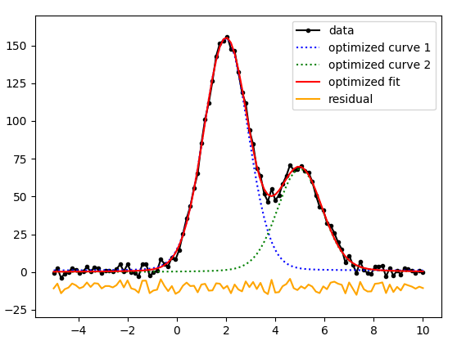
Iterative Curve Fitting: Noisy Peaks
<number>
Notes:
<number>

Slide 30
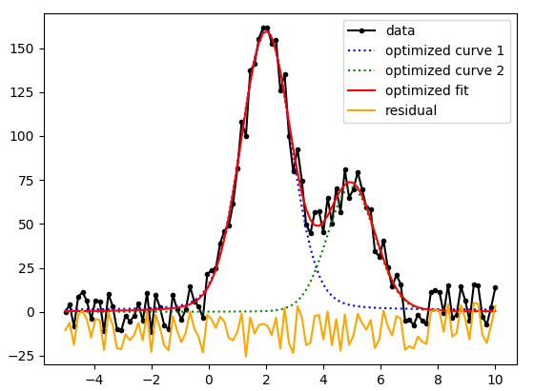
Iterative Curve Fitting: Noisy Peaks
<number>
Notes:
<number>

Slide 31
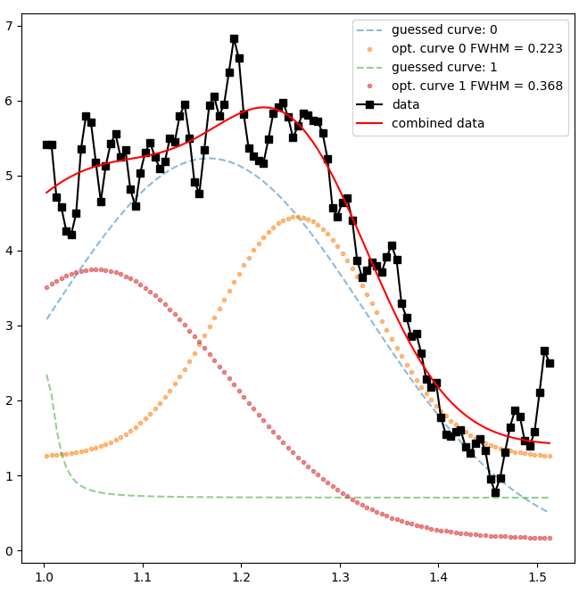
Iterative Curve Fitting: Noisy Peaks
<number>
Notes:
<number>

Slide 32
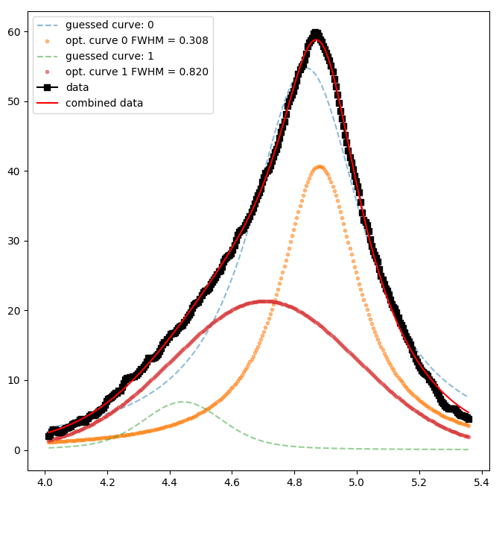
Iterative Curve Fitting: Overlapping Peaks
<number>
Notes:
<number>

Slide 33
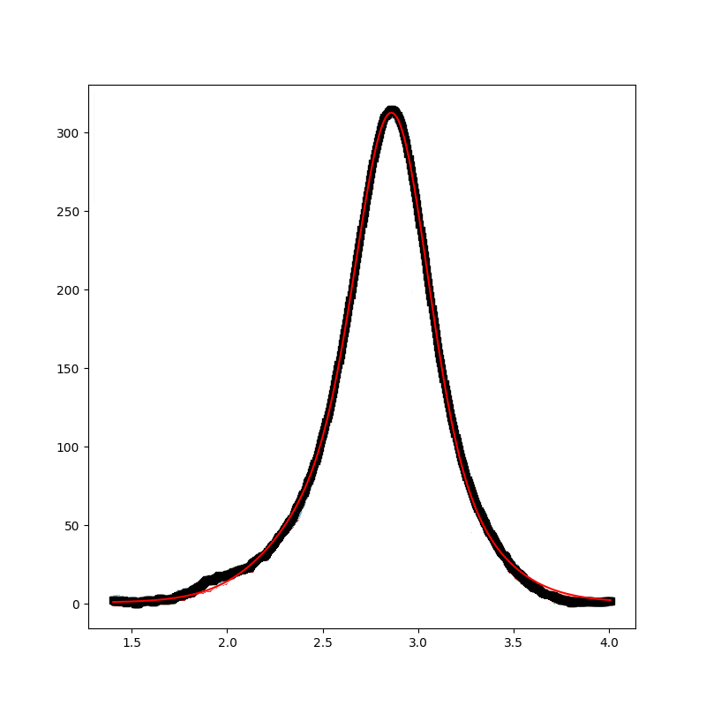
Iterative Curve Fitting: Overlapping Peaks
How many peaks are there?
<number>
Notes:
<number>

Slide 34
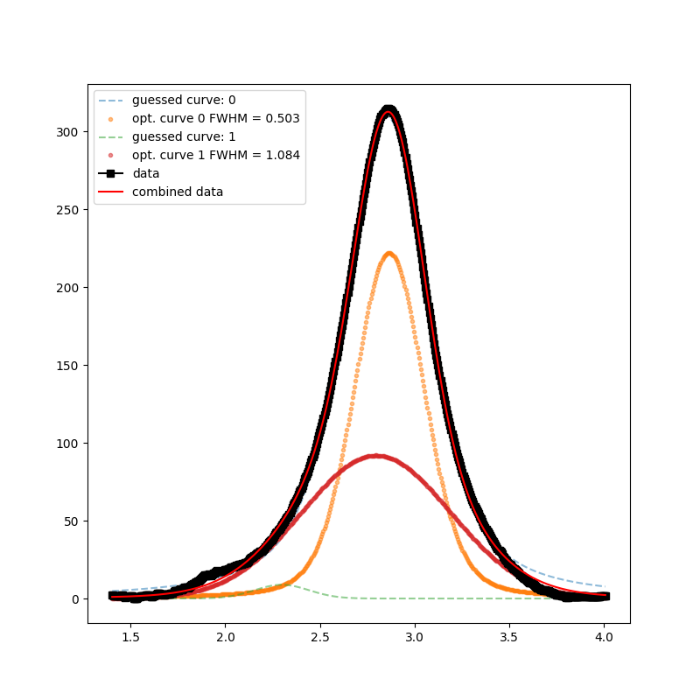
Iterative Curve Fitting: Overlapping Peaks
<number>
Notes:
<number>

Slide 35
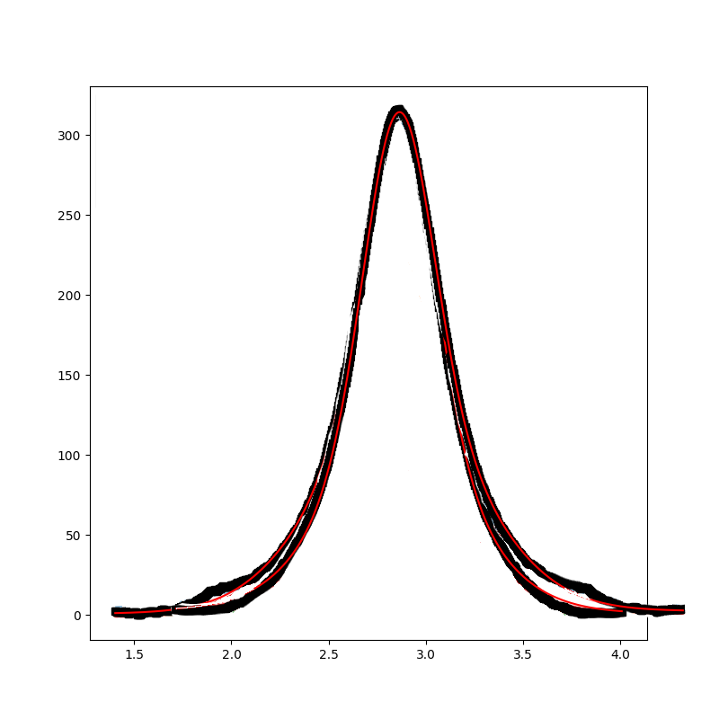
Iterative Curve Fitting: Overlapping Peaks
How many peaks are there?
<number>
Notes:
<number>

Slide 36
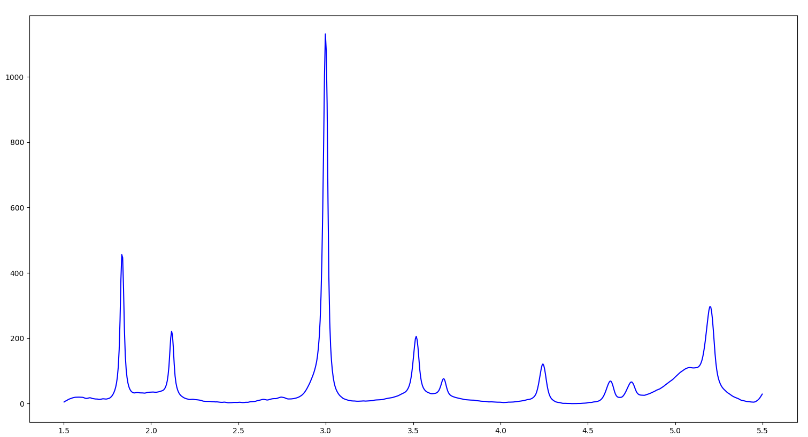
Robust, Fast, Automated, and Beyond Human Perseption
<number>
Notes:
<number>

Slide 37
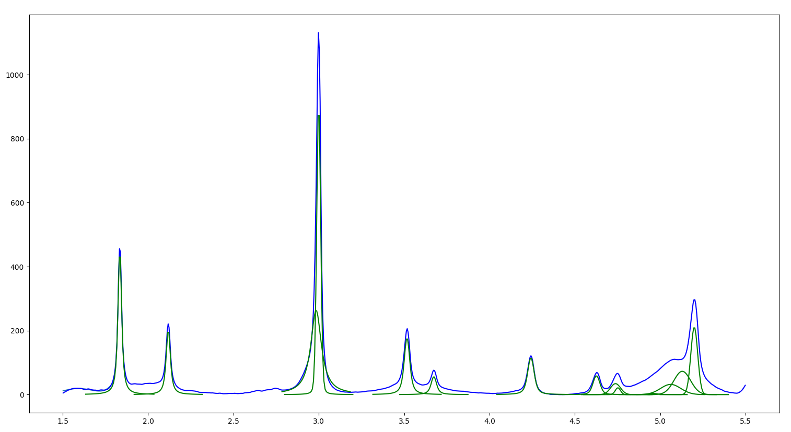
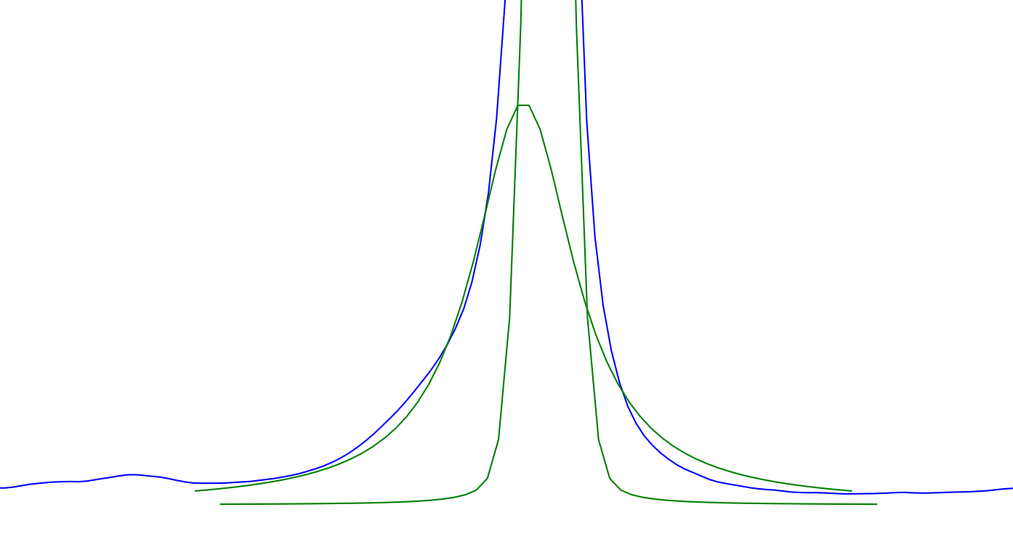
Robust, Fast, Automated, and Beyond Human Perseption
<number>
Notes:
<number>

Slide 38
Further Directions: Blocking
Improved Blocking Method
Faster blocking
More Intelligent Blocking
<number>
Notes:
<number>

Slide 39

Further Directions: Curve Fitting
Improved Peak Extraction
Faster Curve Fitting
Computer Vision
Estimating Noise
Peaks vs Noise
<number>
Notes:
<number>

Slide 40
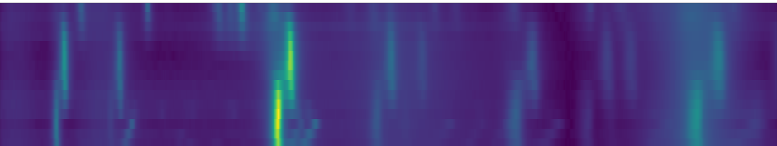
Further Directions: Additional Information
Additional Information
Spacial Positions
Higher dimensional peak fitting
Peaks vs Noise
<number>
Notes:
<number>

Slide 41
Further Directions: Additional Information
Additional Information
Spacial Positions
Higher dimensional peak fitting
Peaks vs Noise
<number>
Notes:
<number>

Slide 42
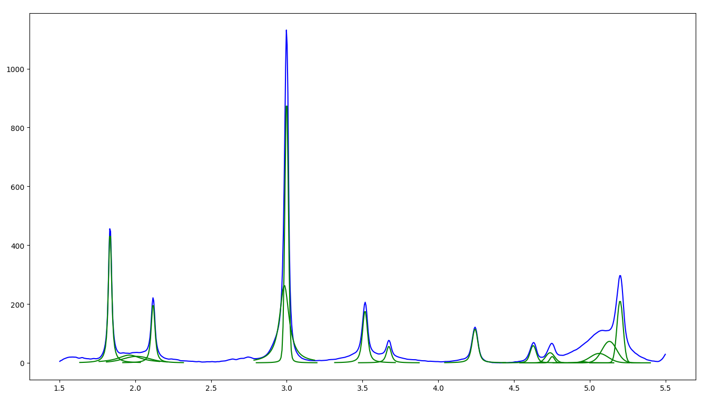
Conclusion
Thank You For Your Attention
Blocking
Iterative Peak Fitting
Robert Tang-Kong
Stanford University | Materials Science and Engineering, PhD student
roberttk@stanford.edu
<number>
Notes:
<number>

Slide 43
Backup Slides
<number>
Notes:
<number>

Slide 44
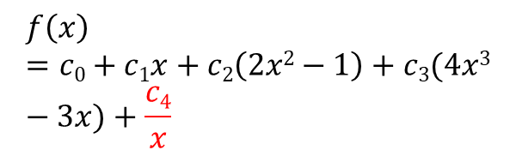
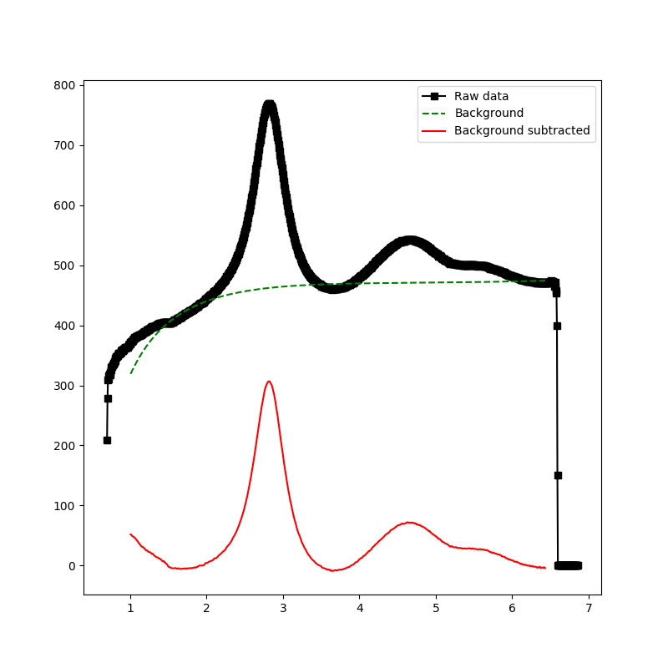
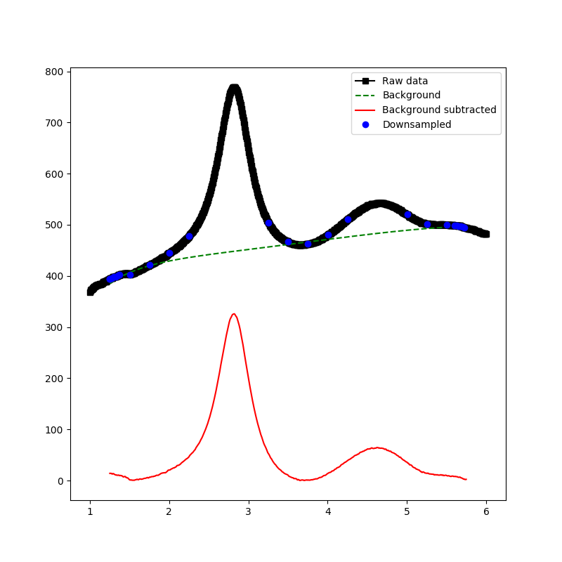
Background Subtraction
Modified Chebyshev Polynomial
Take points below median
Emphasize edge points to pin edges of function
<number>
Notes:
<number>

Slide 45
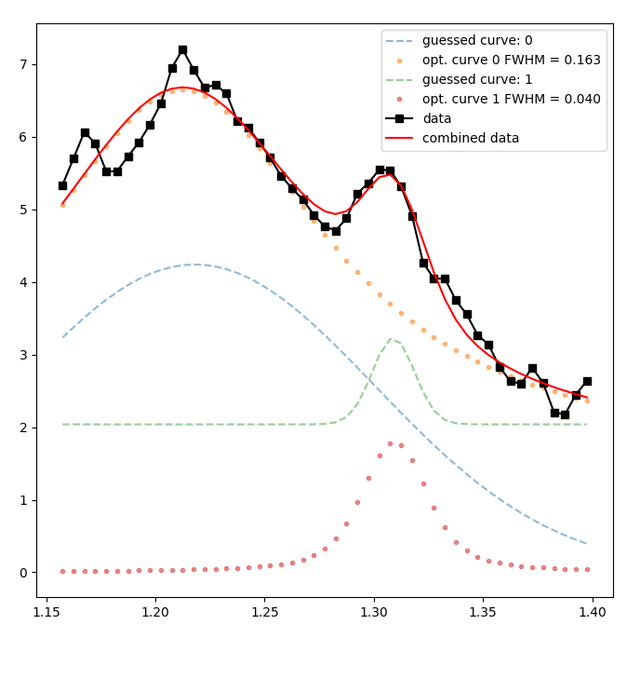
Peak Fitting
<number>
Notes:
<number>

Slide 46
Peak Fitting
<number>
Notes:
<number>

Slide 47
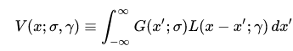
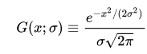
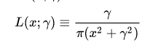
Voigt Profile
<number>
Notes:
<number>

Slide 48
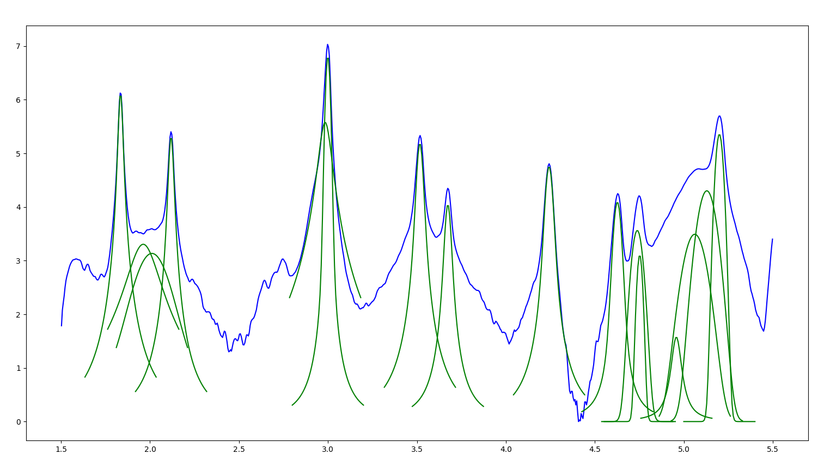
Iterative Curve Fitting: Noisy Peaks (Log)
<number>
Notes:
<number>

Slide 49
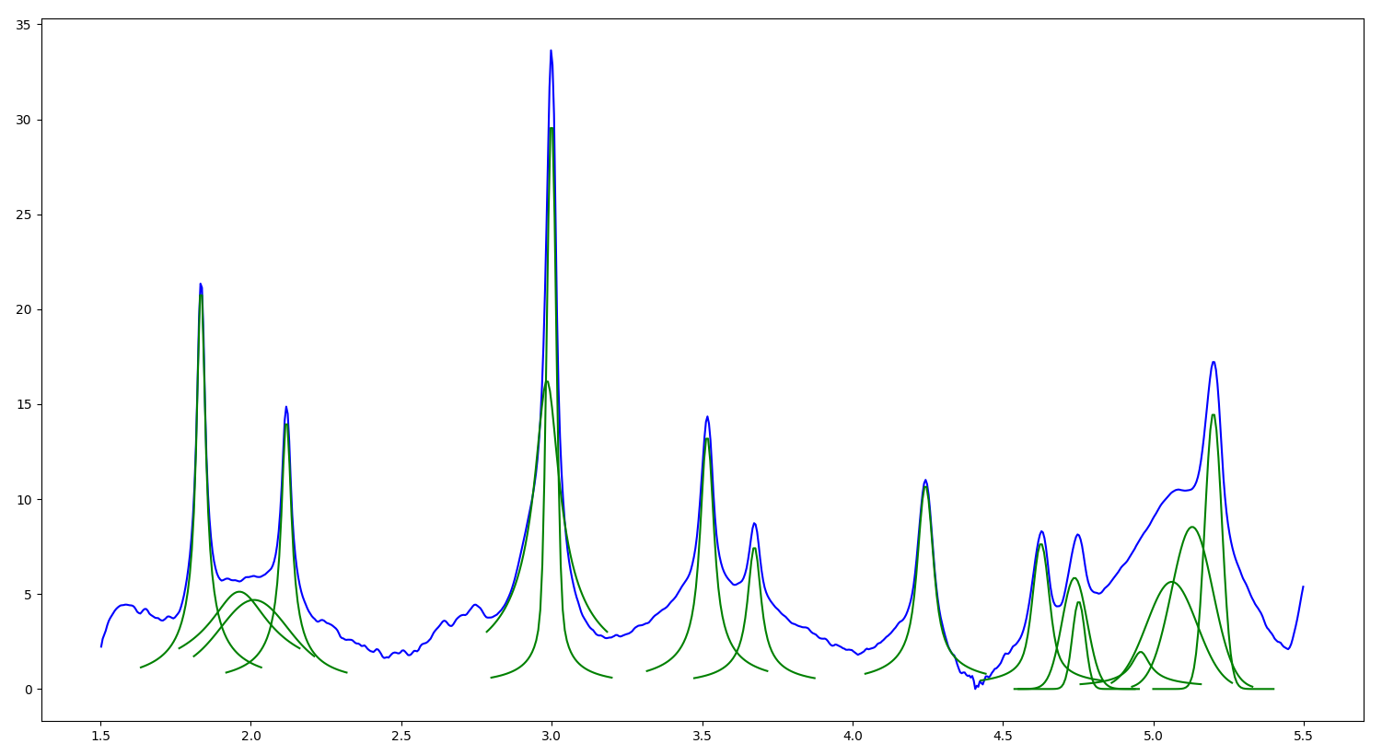
Iterative Curve Fitting: Noisy Peaks (Square Root)
<number>
Notes:
<number>

Slide 50
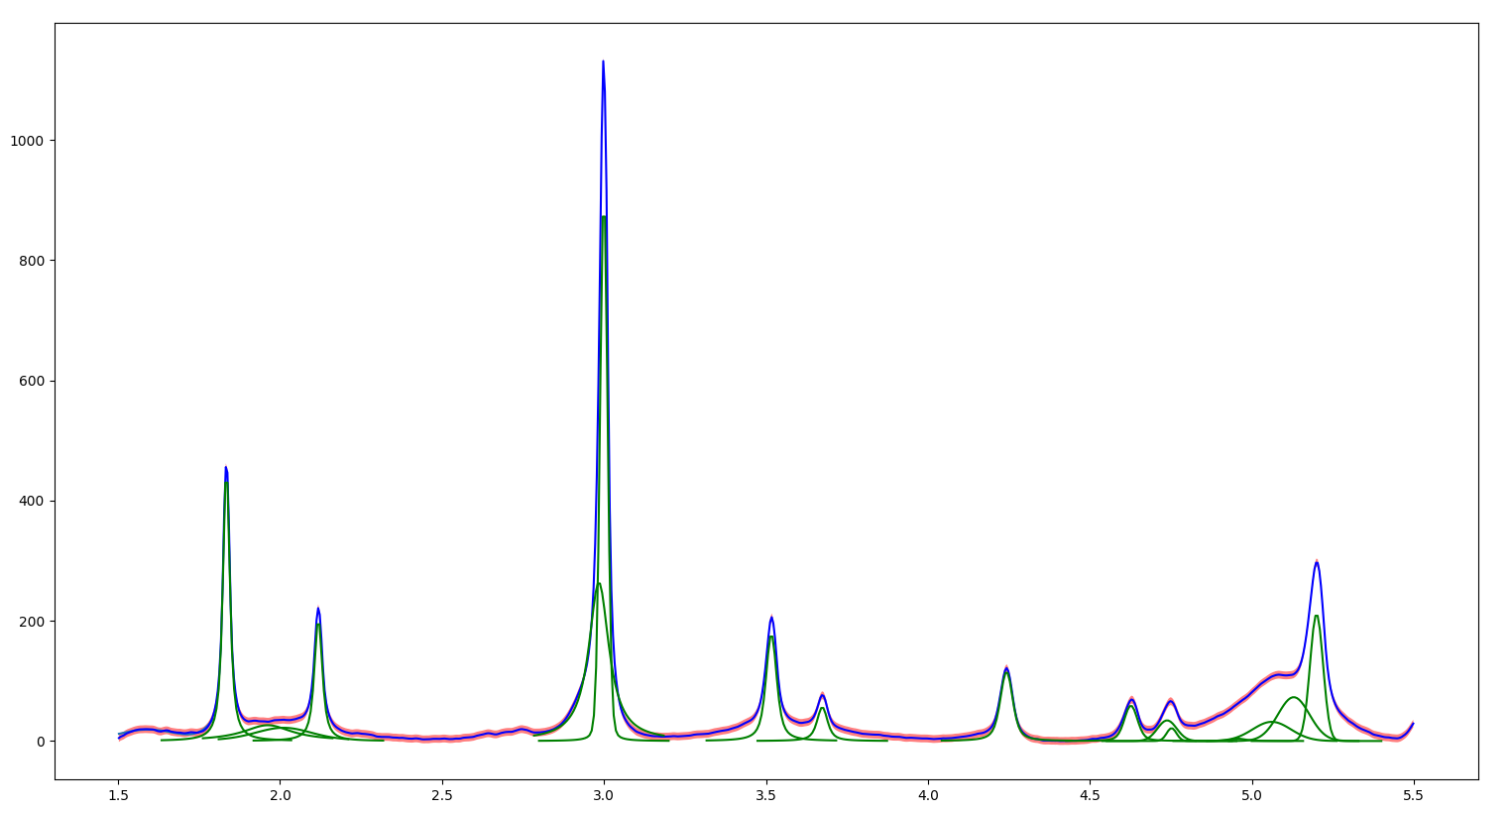
Background Noise
<number>
Notes:
<number>

